Slide 1
A Simplified IoT Architecture
It is an IoT framework that highlights the fundamental building blocks that are common to most IoT systems and which is intended to help you in designing an IoT network.
This framework is presented as two parallel stacks:
The Core IoT Functional Stack
The IoT Data Management and Compute Stack

Slide 2
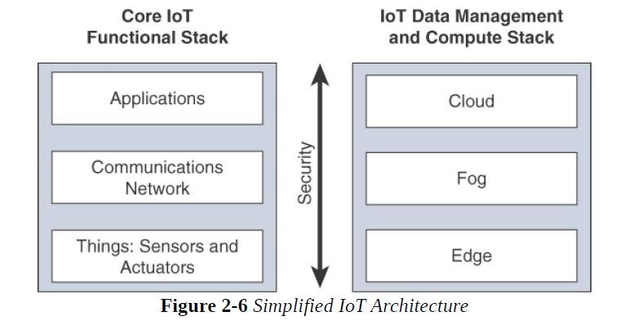
A Simplified IoT Architecture

Slide 3
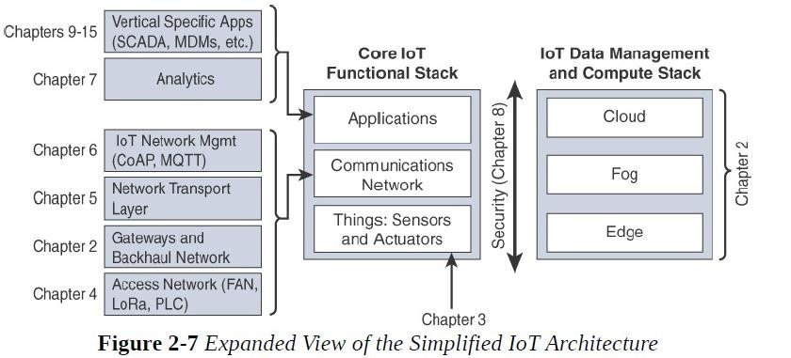

Slide 4
Layer 1: Things: Sensors and Actuators Layer
Most IoT networks start from the object, or “thing,” that needs to be connected.
From an architectural standpoint, the variety of smart object types, shapes, and needs drive the variety of IoT protocols and architectures.

Slide 5
Classification of smart objects
One architectural classification could be:
1. Battery-powered or power-connected:
This classification is based on whether the object carries its own energy supply or receives continuous power from an external power source.
Battery-powered things can be moved more easily than line-powered objects.
However, batteries limit the lifetime and amount of energy that the object is allowed to consume, thus driving transmission range and frequency.

Slide 6
2. Mobile or static:
This classification is based on whether the “thing” should move or always stay at the same location.
A sensor may be mobile because it is moved from one object to another((for example, a viscosity sensor is moved from batch to batch in a chemical plant) or
A sensor may be mobile because it is attached to a moving object (for example, a location sensor on the moving goods in a warehouse or factory floor).
The frequency of the movement may also vary, from occasional to permanent.
The range of mobility (from a few inches to miles away) often drives the possible power source.

Slide 7
3. Low or high reporting frequency:
This classification is based on how often the object should report monitored parameters.
E.g. A rust sensor may report values once a month.
A motion sensor may report acceleration several hundred times per second.
Higher frequencies drive higher energy consumption, which may create constraints on the possible power source (and therefore the object mobility and the transmission range).

Slide 8
4. Simple or rich data:
This classification is based on the quantity of data exchanged at each report cycle .
E.g humidity sensor in a field may report a simple daily index value (on a binary scale from 0 to 255),
An engine sensor may report hundreds of parameters, from temperature to pressure, gas velocity, compression speed, carbon index, and many others.
Richer data typically drives higher power consumption.

Slide 9
5. Report range:
This classification is based on the distance at which the gateway is located.
For example, for your fitness band to communicate with your phone, it needs to be located a few meters away at most.
By contrast, a moisture sensor in the asphalt of a road may need to communicate with its reader several hundred meters or even kilometers away.

Slide 10
6. Object density per cell:
This classification is based on the number of smart objects (with a similar need to communicate) over a given area, connected to the same gateway.
E.g. An oil pipeline may utilize a single sensor at key locations every few miles.
By contrast, telescopes deploy hundreds,and sometimes thousands, of mirrors over a small area, each with multiple gyroscopes, gravity, and vibration sensors.
From a network architectural standpoint, your initial task is to determine which technology should be used to allow smart objects to communicate.
This determination depends on the way the “things” are classified.

Slide 11
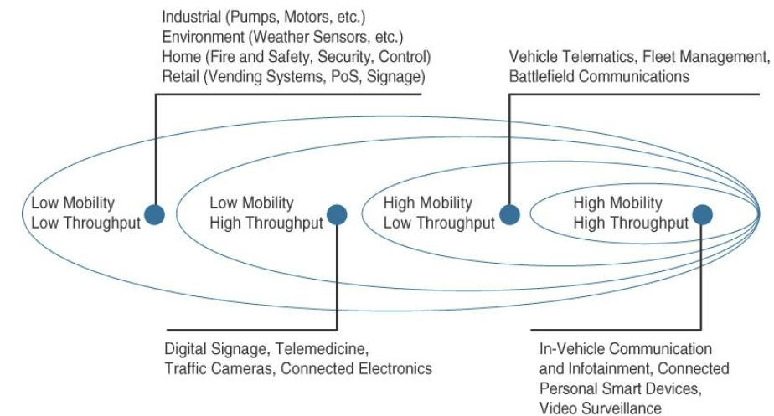
Figure 2.8: Example of Sensor Applications Based on Mobility and Throughput

Slide 12
Layer 2: Communications Network Layer
When smart objects are not self contained, they need to communicate with an external system. In many cases, this communication uses a wireless technology. This layer has four sublayers:
Access Network Sublayer
Gateways and backhaul network sublayer
Network transport sublayer
IoT network management sublayer

Slide 13
i. Access Network Sublayer
There is a direct relationship between the IoT network technology we choose and the type of connectivity topology this technology allows.
Each technology was designed with a certain number of
use cases in mind
what to connect, where to connect, how much data to transport at
what interval and over what distance.
For each new variety of applications and special use cases that we encounter, an access technology will be required.
IoT sometimes reuses existing access technologies whose characteristics match more or less closely to the IoT use case requirements.

Slide 14
One key parameter determining the choice of access technology is the range between the smart object and the information collector.
Range estimates are grouped by category names that illustrate the environment or the vertical where data collection over that range is expected. Common groups are:
Name of Group | Scale | Description
PAN (Personal Area N/W) | Few meters | Personal space around a person. Bluetooth
HAN(Home Area N/W) | Few tens of meters | A single house unit Zigbee and BLE
NAN(Neighborhood Area NW | Few hundred of meters | A group of house units from which the data is collected.
FAN | Several tens of meters to several 100 of meters | An outdoor area larger than a single group of house units. Not secured and not controlled.
LAN | Upto 100 meters | This term is very common in networking, and it is therefore also commonly used in the IoT space when standard networking technologies (such as Ethernet or IEEE 802.11) are used.

Slide 15
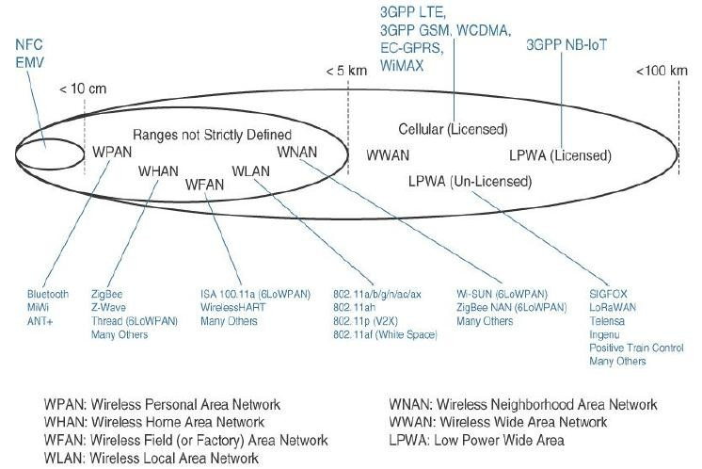
Figure 2.9 : Access Technologies and Distances

Slide 16
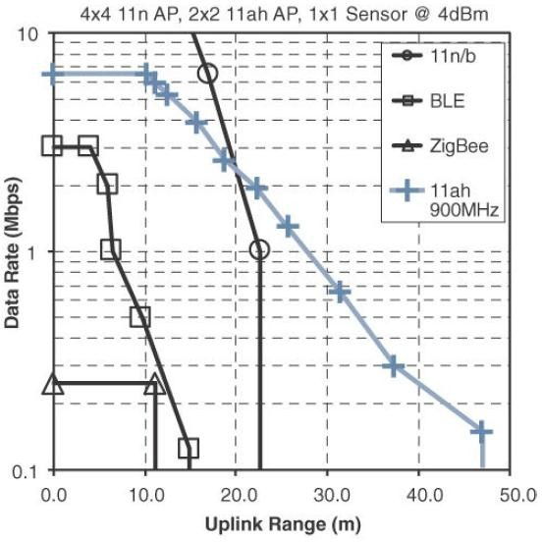
Figure 2.10 demonstrates four technologies representing WHAN to WLAN ranges and compares the throughput and range that can be achieved in each case.
Figure 2.10 : Range Versus Throughput for Four WHAN to WLAN Technologies

Slide 17
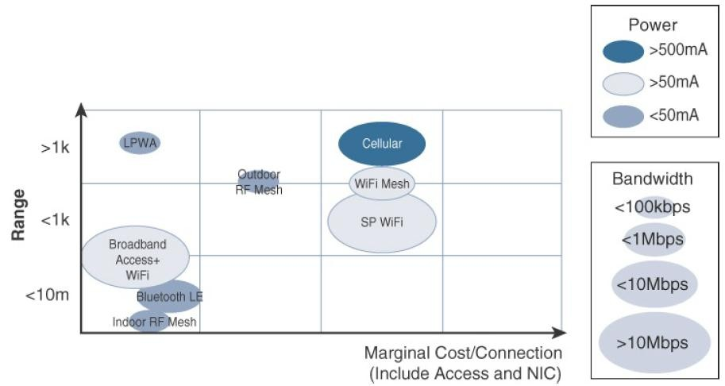
Figure 2.11 combines cost, range, power consumption, and typical available bandwidth for common IoT access technologies.
Figure 2.11 : Comparison Between Common Last-Mile Technologies in Terms of
Range Versus Cost, Power, and Bandwidth

Slide 18
Communication topologies:
Some technologies offer flexible connectivity structure to extend communication possibilities.
Point-to-point topologies:
These topologies allow one point to communicate with another point.
This topology is uncommon for IoT access, as it would imply that a single object can communicate only with a single gateway.

Slide 19
Point-to-multipoint topologies:
These topologies allow one point to communicate with more than one other points.
Most IoT technologies where one or more than one gateways communicate with multiple smart objects are in this category.

Slide 20
To form a network, a device needs to connect with another device.
When both devices fully implement the protocol stack functions, they can form a peer-to peer network.
However, in many cases, one of the devices collects data from the others. —> star topology
The sensor can implement a subset of protocol functions to perform just a specialized part (communication with the coordinator). Such a device is called a reduced-function device (RFD).
A RFD cannot be a coordinator. The RFD also cannot implement direct communications to another RFD.

Slide 21
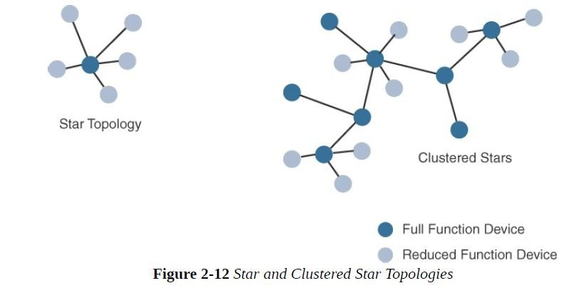
The coordinator that implements the full network functions is called, by contrast, a full-function device (FFD).
The FFD can communicate directly with another FFD or with more than one FFD, forming multiple peer-to-peer connections.
Topologies where each FFD has a unique path to another FFD are called cluster tree topologies.
FFDs in the cluster tree may have RFDs, resulting in a cluster star topology.

Slide 22
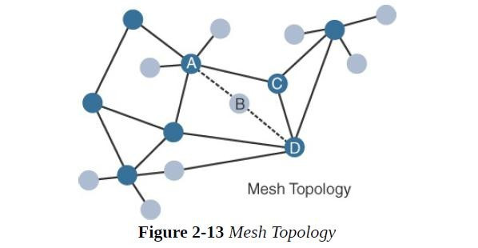
Other point-to-multipoint technologies allow a node to have more than one path to another node, forming a mesh topology.
Nodes A and D are too far apart to communicate directly. In this case, communication can be relayed through nodes B or C. Node B may be used as the primary relay
Full mesh networks are computationally expensive and are uncommon in IoT

Slide 23
Gateways and Backhaul Sublayer
Data collected from a smart object may need to be forwarded to a central station where data is processed.
As this station is often in a different location from the smart object, data directly received from the sensor through an access technology needs to be forwarded to another medium (the backhaul) and transported to the central station.
The gateway is in charge of this inter-medium communication.
When the smart object’s operation is controlled from a local site, and when the environment is stable (for example, factory or oil and gas field), Ethernet can be used as a backhaul.
WiMAX (802.16) is an example of a longer-range technology. WiMAX can achieve ranges of up to 50 kilometers with rates of up to 70 Mbps

Slide 24
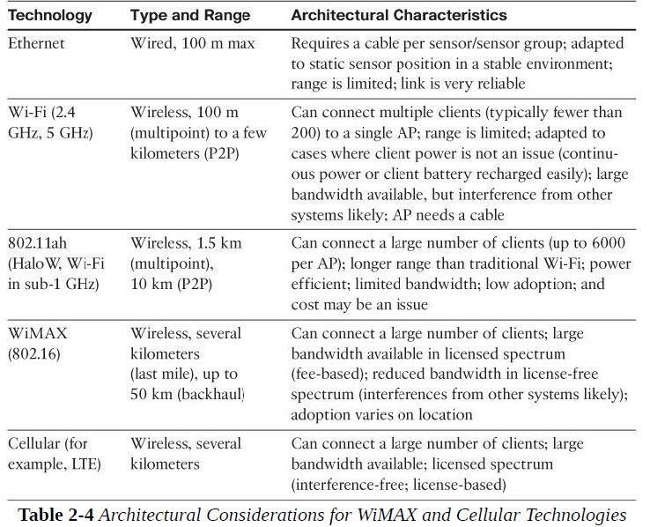

Slide 25
Network Transport Sublayer
Transport data from one node to other
For this we need transport layer protocols like TCP/IP, UDP.

Slide 26
Network Transport Sublayer
We know that a hierarchical communication architecture in which a series of smart objects report to a gateway that conveys the reported data over another medium and up to a central station.
However, practical implementations are often flexible, with multiple transversal communication paths

Slide 27
communication structure involve
peer-to-peer
point-to-point
point-to-multipoint (gateway or head-end)
unicast and multicast communications update to one or multiple systems)
(software

Slide 28
communication occurs over multiple media
For ex: power lines inside our house or a short- range wireless system like indoor Wi-Fi and/or ZigBee
a longer-range wireless system to the gateway, and yet another wireless or wired medium for backhaul transmission.
To allow for such communication structure, a network protocol with specific characteristics needs to be implemented.

Slide 29
The protocol needs to be open and standard-based to
accommodate multiple industries and multiple media.
Scalability (to accommodate thousands or millions of sensors in a single network) and security are also common requirements.
IP is a protocol that matches all these requirements.
The flexibility of IP allows this protocol to be embedded in objects of very different natures, exchanging information over very different media, including low-power, lossy, and low-bandwidth networks.

Slide 30
Finally, the transport layer protocols built above IP (UDP and TCP) can easily be leveraged to decide whether the network should control the data packet delivery (with TCP) or whether the control task should be left to the application (UDP).

Slide 31
IoT Network Management Sublayer
IP, TCP, and UDP bring connectivity to IoT networks.
Upper-layer protocols need to take care of data transmission between the smart objects and other systems.
Multiple protocols have been created to solve IoT data communication problems.
some IoT implementers have suggested HTTP which has a client and server component.
But HTTP is something of a fat protocol and was not designed to operate in constrained environments with low memory, low power, low bandwidth, and a high rate of packet failure.

Slide 32
IoT Network Management Sublayer
IP, TCP, and UDP bring connectivity to IoT networks.
Upper-layer protocols need to take care of data transmission between the smart objects and other systems.
In IOT, nodes and networks are constrained . So features of the network like BW,frequency, processing power etc. need to be managed.
Additional protocols like MQTT,COAP etc. must be in place to allow head end applications to exchange the data.

Slide 33
Despite these limitations, other web- derived protocols have been suggested for the IoT space.
One example is WebSocket.
WebSocket is part of the HTML5 specification, and provides a simple bidirectional connection over a single connection
WebSocket is often combined with other protocols, such as MQTT to handle the IoT-specific part of the communication.
With the same logic of reusing well-known methods, Extensible Messaging and Presence Protocol (XMPP) was created.
XMPP is based on instant messaging and presence.
It allows the exchange of data between two or more systems and supports presence and contact list maintenance

Slide 34
Constrained Application Protocol (CoAP).
CoAP uses some methods similar to those of HTTP (such as Get, Post, Put, and Delete) but implements a shorter list, thus limiting the size of the header.
CoAP also runs on UDP (whereas HTTP typically uses TCP). CoAP also adds a feature that is lacking in HTTP and very useful for IoT.
Another common IoT protocol utilized in these middle to upper layers is Message Queue Telemetry Transport (MQTT).

Slide 35
MQTT(Message Queue Telemetry Transport) uses a broker-based architecture.
The sensor can be set to be an MQTT publisher (publishes a piece of information),
The application that needs to receive the information can be set as the MQTT subscriber, and
Any intermediary system can be set as a broker to relay the information between the publisher and the subscriber(s).
MQTT runs over TCP. A consequence of the reliance on TCP is that an MQTT client typically holds a connection open to the broker at all times.

Slide 36
Layer 3: Applications and Analytics Layer
Once connected to a network, our smart objects exchange information with other systems.
From an architectural standpoint, basic classification can be as follows:
Analytics Versus Control Applications
Data Versus Network Analytics

Slide 37
Analytics Versus Control Applications
Multiple applications can help increase the efficiency of an IoT network.
Each application collects data and provides a range of functions based on analyzing the collected data.
Analytics Application
Control Application

Slide 38
Analytics Versus Control Applications
Analytics Application
This type of application collects data from multiple smart objects, processes the collected data, and displays information resulting from the data that was processed.
The display can be about any aspect of the IoT network, from historical reports, statistics, or trends to individual system states.
Analytics application processes the data to convey a view of the network
Control Application
This type of application controls the behaviour of the smart object or the behaviour of an object related to the smart object.
For ex : a pressure sensor may be connected to a pump.

Slide 39
Analytics Versus Control Applications
Multiple applications can help increase the efficiency of an IoT network.
Each application collects data and provides a range of functions based on analyzing the collected data.
Analytics Application
This type of application collects data from multiple smart objects, processes the collected data, and displays information resulting from the data that was processed.
The display can be about any aspect of the IoT network, from historical reports, statistics, or trends to individual system states.
Control Application
This type of application controls the behaviour of the smart object or the behaviour of an object related to the smart object.
For ex : a pressure sensor may be connected to a pump

Slide 40
An example of control system architecture is SCADA.
SCADAwas developed as a universal method to
access remote systems and send instructions.
One example where SCADA is widely used is in the control and monitoring of remote terminal units (RTUs) on the electrical distribution grid.

Slide 41
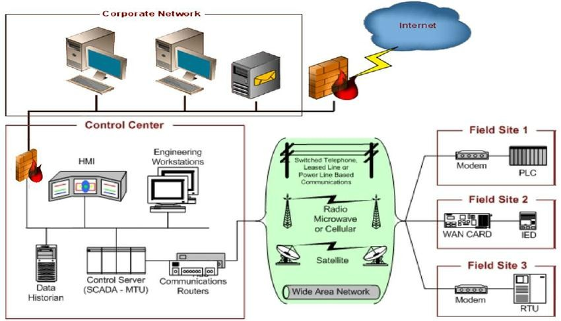
SUPERVISORY CONTROL AND DATA ACQUISITION (SCADA)

Slide 42
Data Versus Network Analytics
Data analytics:
This type of analytics processes the data collected by smart objects and combines it to provide an intelligent view related to the IoT system.
e.g A dashboard can display an alarm when a weight sensor detects that a shelf in a store is empty.
In a more complex case, the temperature, pressure,wind , humidity and light levels collected from thousands of sensors can be combined and processed to determine likelihood of a storm and its possible path.-- very complex data processing
Data analytics can also monitor the IoT system itself.
For example, a machine or robot in a factory can report data about its own movements.
This data can be used by an analytics application to report degradation in the movement speeds, which may be indication of a need to service the robot before a part breaks.
.

Slide 43
Data Versus Network Analytics
Network analytics:
Most IoT systems are built around smart objects connected to the network
A loss or degradation in connectivity is likely to affect the efficiency of the system. Such a loss can have dramatic effects.
For example, open mines use wireless networks to automatically pilot dump trucks. A lasting loss of connectivity may result in an accident or degradation of operations efficiency (automated dump trucks typically stop upon connectivity loss).
On a more minor scale, loss of connectivity means that data stops being fed to your data analytics platform, and the system stops making intelligent analyses of the IoT system.
A similar consequence is that the control module cannot modify local object behaviors anymore.

Slide 44
IoT Data Management and Compute Stack
The massive scale of IoT networks is fundamentally driving new architectures. As per the projections by Cisco nearly 50 billion devices will be connected to the IoT networks by the year 2020.
In fact, the data generated by IoT sensors is one of the single biggest challenges in building an IoT system.

Slide 45
IoT Data Management and Compute Stack
The massive scale of IoT networks is fundamentally driving new architectures.
The data generated by IoT sensors is one of the single biggest challenges in building an IoT system.
In the case of modern IT networks, the data sourced by a computer or server is typically generated by the client/server communications model, and it serves the needs of the application.
In sensor networks, the vast majority of data generated is unstructured and of very little use on its own.

Slide 46
IoT Data Management and Compute Stack
In sensor networks, the vast majority of data generated is unstructured and of very little use on its own.
In most cases, the processing location is outside the smart object. A natural location for this processing activity is the cloud.
Smart objects need to connect to the cloud, and data processing is centralized.

Slide 47
One advantage of this model is simplicity. Objects just need to connect to a central cloud application.
This model also has some limitations.
The data volume increases with more number of smart objects being connected to the network which in turn creates a new requirements including:
Minimizing latency(delay)
Conserving network bandwidth
Increasing local efficiency
– Collecting the data across a wide geographic area with different environmental conditions may not be useful.
–Analysing different areas in the same cloud system may not be necessary for immediate efficiency.

Slide 48
An important design consideration, therefore, is :
“how to design an IoT network to manage this volume of data in an efficient way so that data can be quickly analyzed and lead to business benefits.”
Challenges:
Data storage and Analysis
BW management :Impedance Mismatch of data generated by IoT system and management application’s ability to deal with that data.

Slide 49
An important design consideration, therefore, is :
“how to design an IoT network to manage this volume of data in an efficient way so that data can be quickly analyzed and lead to business benefits.”

Slide 50
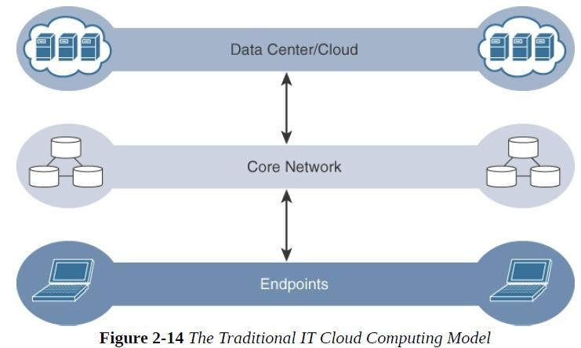
Data is generally stored in the data center, and the physical links from access to core are typically high bandwidth, meaning access to IT data is quick.

Slide 51
Data management in traditional IT systems is very simple.
The endpoints (laptops, printers, IP phones, and so on) communicate over an IP core network to servers in the data center or cloud.
Data is generally stored in the data center, and the physical links from access to core are typically high bandwidth, meaning access to IT data is quick.

Slide 52
IoT systems function differently.
Several data-related problems need to be addressed:
Bandwidth in last-mile IoT networks is very limited.(<= 10s of kbps/device or even less)
Latency can be very high.(Large IoT networks often introduce a latency of 100s or 1000s of msecs instead of msecs)
Network backhaul from the gateway can be unreliable and often depends on 3G/LTE or even satellite links. Backhaul links can also be expensive if per byte data usage model is necessary.
The volume of data transmitted over the backhaul can be high, and much of the data may not really be that interesting(such as simple polling messages).
Big data is getting bigger. The concept of storing and analyzing all sensor data in the cloud is impractical.

Slide 53
Fog Computing
The solution to the challenges encountered in data management is to distribute data management throughout the IoT system, as close to the edge of the IP network as possible.
The best-known embodiment of edge services in IoT is fog computing.
--Any device with computing, storage, and network connectivity can be a fog node.
--Examples include industrial controllers, switches, routers,
embedded servers and IoT gateways
Analyzing IoT data close to where it is collected minimizes latency, offloads gigabytes of network traffic from the core network, and keeps sensitive data inside the local network.

Slide 54
Note:
Just like cloud exists in the sky, fog sits/rests near the ground.
In the same way intention of fog computing is to place resources as close to ground (i.e IoT devices) as possible.
Fog node allows intelligence gathering and control from closest possible point and in doing so it allows better performance over the constrained networks.

Slide 55
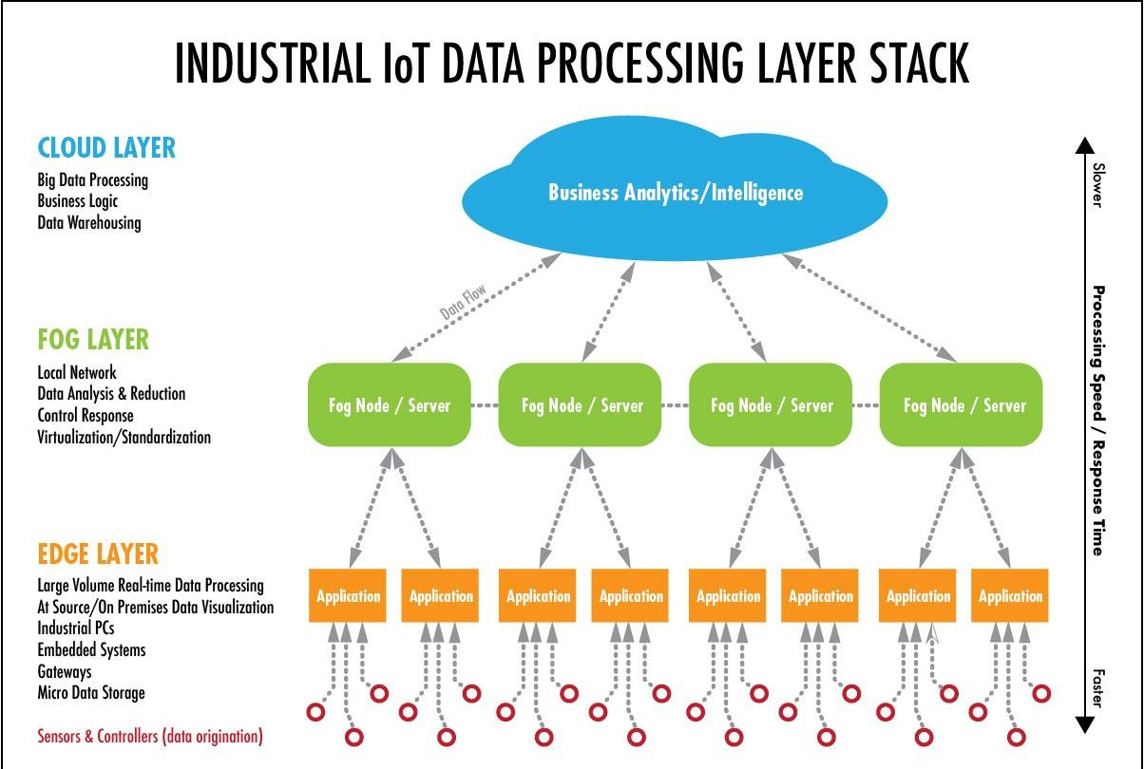

Slide 56
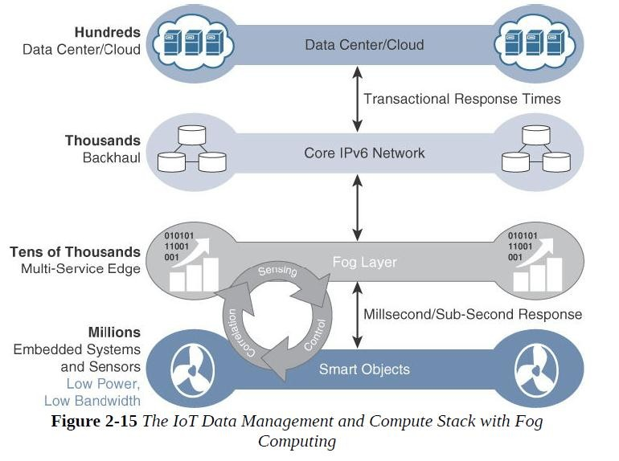

Slide 57
The defining characteristic of fog computing are as follows:
1. Contextual location awareness and low latency: The fog node sits as close to the IoT endpoint as possible to deliver distributed computing.
2. Geographic distribution: In sharp contrast to the more centralized
cloud, the services and applications targeted by the fog nodes demand
widely distributed deployments.
3. Deployment near IoT endpoints: Fog nodes are typically deployed in the presence of a large number of IoT endpoints. For example, typical metering deployments often see 3000 to 4000 nodes per gateway router, which also functions as the fog computing node.
4. Wireless communication between the fog and the IoT endpoint:
Although it is possible to connect wired nodes, the advantages of fog
are greatest when dealing with a large number of endpoints, and
wireless access is the easiest way to achieve such scale.
5. Use for real-time interactions: Important fog applications involve
real-time interactions rather than batch processing. Preprocessing of
data in the fog nodes allows upper-layer applications to perform batch
processing on a subset of the data.

Slide 58
Edge Computing
In edge computing, the data generated by these devices are stored and computed at the device itself, and the system doesn’t look at sharing this data with the cloud.
An edge solution should support the most common protocols. For example, these include Z-Wave, ZigBee, KNX, Bluetooth LE, HomeConnect, Modbus, ONVIF, EnOcean, BACnet, OPC UA, LoRa, Siemens S7.

Slide 59
Edge computing: Need
There are several reasons why the edge computing market is increasing rapidly.
In addition to the greater number of connected devices, there are three key drivers of growth for edge computing:
Latency — For many time-sensitive applications, the process being monitored requires a response in near real time, with near-zero latency. In these situations a round trip of data to and from the cloud or a corporate data center is impractical.
Bandwidth — Both the physical limits of available bandwidth and the cost of transmitting large quantities of data make edge computing an attractive alternative.
Reliability — Network congestion can interrupt the flow of data, causing unacceptable interruptions in use cases such as point-of-sale systems.

Slide 60
Examples of Edge
Autonomous Vehicles, Electric Vehicles and Charging Stations
Edge computing features such as lane-departure warning and self-parking applications are already widely available.
And as the ability of vehicles to interact with their environment becomes more widespread, so will the need for a fast and responsive network.
Autonomous vehicles will operate in concert with other connected vehicles,
traffic management systems,
roadside units and
pedestrians on busy thoroughfares and at intersections.

Slide 61
Electric vehicles:
need continuous monitoring and can use edge computing for management of data to support predictive maintenance.
EV batteries must be monitored, as their longevity depends on the individual habits of drivers, the congestion of the areas they travel and how often they are charged.
Edge computing supports data aggregation to report the actionable data for performance and maintenance.
In EV charging stations:
edge computing can support
real time monitoring and data aggregation of a range of usage and
availability metrics to support optimization of charging stations and
planning for placement of future stations.

Slide 62
Traffic Management Systems: Highly sophisticated systems today, like New York City's traffic management system,
can adjust the timing of traffic signals,
manage the opening and closing of extra traffic lanes,
ensure communications can continue in the case of a public emergency, and
take other real-time actions to improve safety and convenience.
In public transit applications, edge computing systems installed in buses, passenger rail systems and paratransit vehicles can
aggregate and send only the data needed for to support in-vehicle processes and
dispatcher insights.
Smart Cities, Clean Energy and Green Technology: The green tech movement is growing. Cities and smart grid systems can use edge computing devices
to monitor public buildings and facilities for greater efficiency in
lighting,
heating,
clean energy and more.

Slide 63
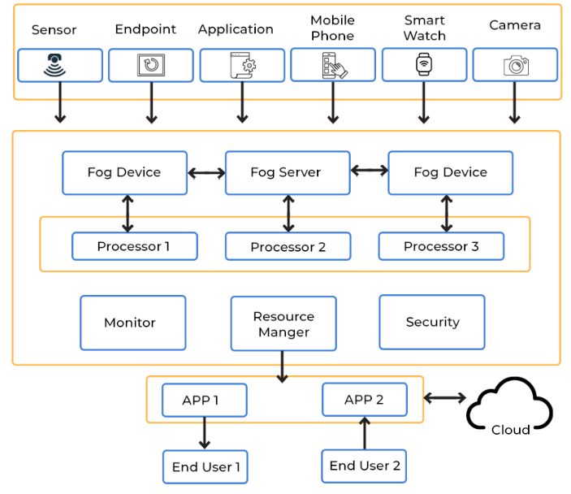
FOG Computing
Any device with computing, storage, and network connectivity can be a fog node.
Examples include:
industrial controllers,
switches,
routers,
embedded servers, and
video surveillance cameras.

Slide 64
FOG computing
Application of Fog Computing
It's utilized when only a small amount of data has to be sent to the cloud. This data is chosen for long-term storage and is accessed by the host less frequently.
It's utilized when a large number of services must be delivered over a broad region and at various places.
Fog computing is required for devices that are subjected to demanding calculations and processing.
Fog computing is utilized in IoT devices (for example, the Car-to-Car Consortium in Europe), Devices with Sensors and Cameras (IIoT-Industrial Internet of Things), and other applications.

Slide 65
The characteristic of fog computing are as follows:
The characteristic of fog computing are as follows:
1. Contextual location awareness and low latency
2. Geographic distribution
3. Deployment near IoT endpoints
4. Wireless communication between the fog and the IoT endpoint
5. Use for real-time interactions

Slide 66
Advantages of Fog Computing
The quantity of data that has to be transmitted to the cloud is reduced using this method.
Because the distance that data has to travel is decreased, network bandwidth is saved.
Reduces the system's reaction time.
Because the data is kept near to the host, it increases the system's overall security.

Slide 67
Application of FOG
1. Smart homes One of the most common fog computing use cases is a smart home. A smart home consists of
a technology-controlled ventilation and heating system such as the Nest Learning Thermostat,
smart lighting,
programmable shades and sprinklers,
smart intercom systems to communicate with people indoors as well as those at the door, and
an intelligent alarm system.
Fog computing can be used to create a personalized alarm system. It can also be used to automate certain events, such as turning on water sprinklers based on time and temperature.

Slide 68
2. Smart cities Smart cities aspire to be automated at every front, from garbage collection to traffic management.
Fog computing is particularly pertinent when it comes to traffic regulation.
Sensors are set up at traffic signals and road barriers for detecting pedestrians, cyclists, and vehicles.
Speedometers can measure how fast they are traveling and how likely it can result in a collision.
These sensors use wireless and cellular technology to collate this data.
Traffic signals automatically turn red or stay green for a longer time based on the information processed from these sensors.

Slide 69
3. Video surveillance The most prevalent example of fog computing is perhaps video surveillance, given that continuous streams of videos are large and cumbersome to transfer across networks.
The nature of the involved data results in latency problems and network challenges.
Costs also tend to be high for storing media content.
Video surveillance is used in malls and other large public areas and has also been implemented in the streets of numerous communities.
Fog nodes can detect anomalies in crowd patterns and automatically alert authorities if they notice violence in the footage.

Slide 70
4. Healthcare
The healthcare industry is one of the most governed industries, with regulations such as HIPAA being mandatory for hospitals and healthcare providers.
This sector is always looking to innovate and address emergencies in real-time, such as a drop in vitals.
One way of doing it is using data from wearables, blood glucose monitors, and other health apps to look for signs of bodily distress.
This data should not face any latency issues as even a few seconds of delay can make a huge difference in a critical situation, such as a stroke.

Slide 71
5. Others Other industries that use fog computing include retail, oil & gas, government & military, and hospitality. Personal assistants such as Siri and Alexa are available across devices and are compatible with most, such as smartwatches.
This flexibility and presence mean that we can count on fog computing to become a crucial part of various industry verticals. Any enterprise that offers real-time solutions will need to incorporate fog computing into its existing cloud infrastructure.

Slide 72
Cloud Computing
Cloud computing is
mainly to store, process and analyze massive volumes of data for deeper insights using powerful data analytics enginesand ML mechanisms which edge computing never be able to support
It contributes to
reduce the downtime and energy consumption
Increase the production rate
Optimization
Capacity planning etc

Slide 73
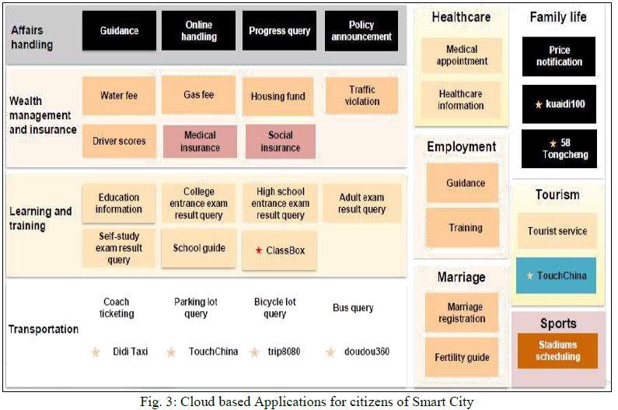

Slide 74
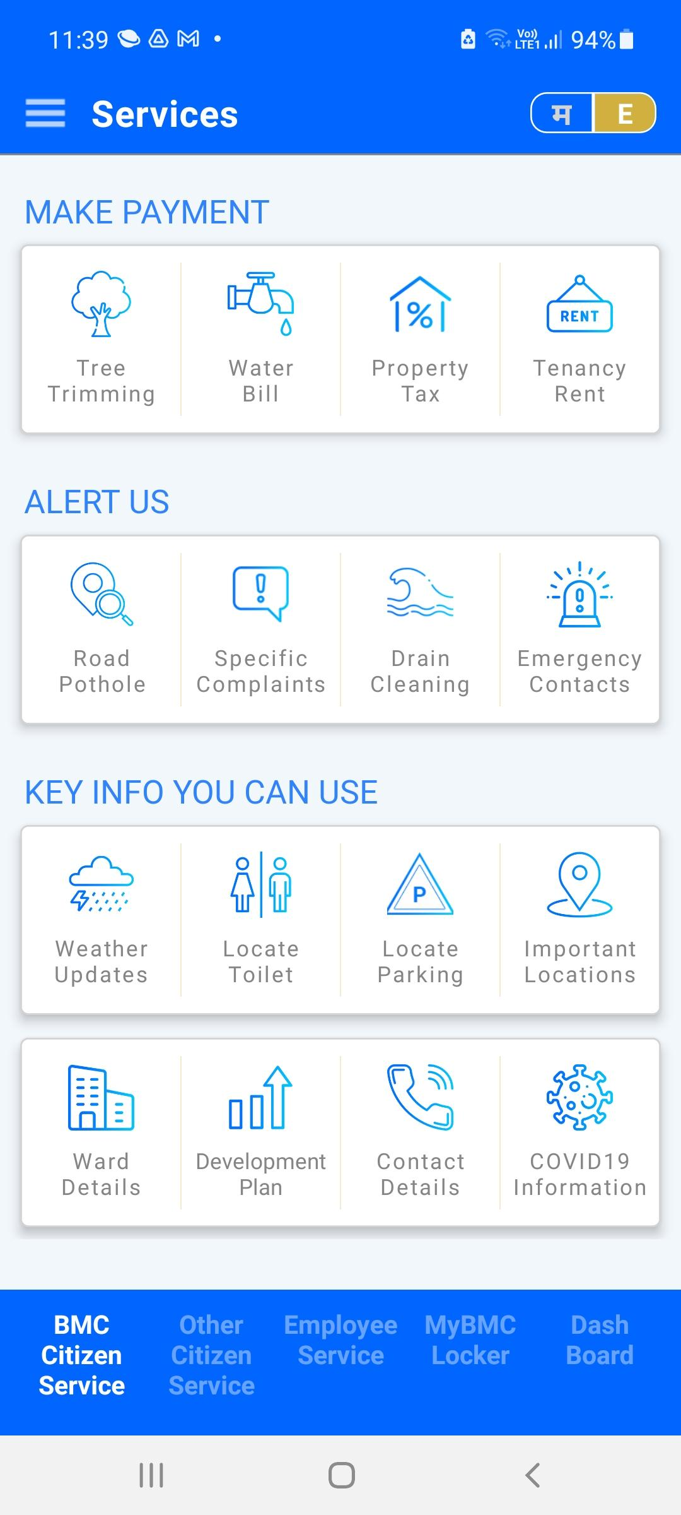
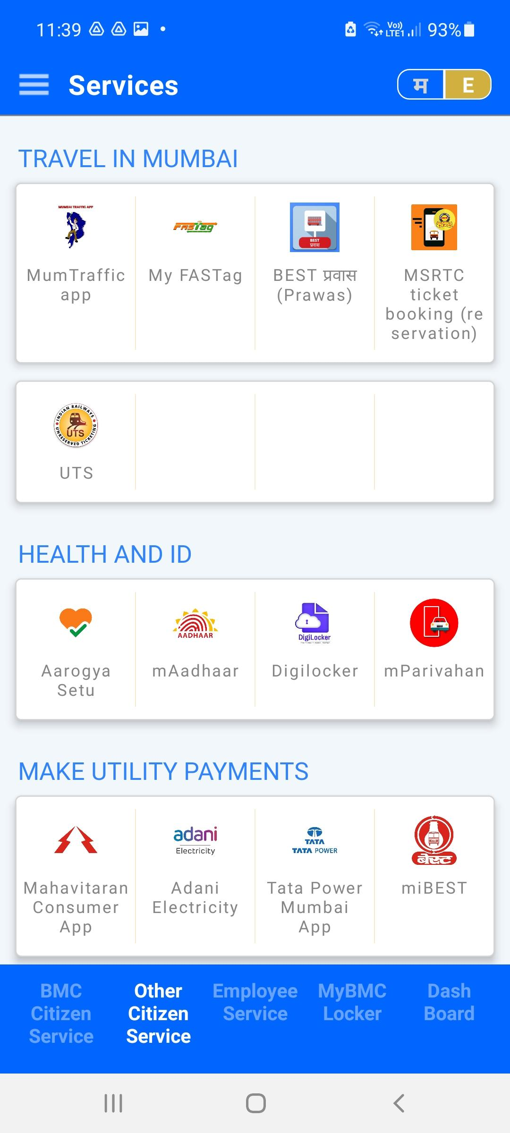

MyBMC App

Slide 75
Applications
Connected Roadways
Connected factories
Smart connected buildings
Smart creatures
Population monitoring
Railway surveillance system
Railway track monitoring system
Train monitoring and reporting system
Every group will
Select one example
Identify the layer specific actions/responses/activities (for each layer - edge - fog - cloud)
Identify the sensors/actuators required
Identify the best suited protocols
Select the architecture
Identify the information needed to be sent at the higher level

Slide 76
Edge Computing (95)
Fog computing solutions are being adopted by many industries, and efforts to develop distributed applications and analytics tools are being introduced at an accelerating pace.
The natural place for a fog node is in the network device
that sits closest to the IoT endpoints, and these nodes are typically spread throughout an IoT network.
However, in recent years, the concept of IoT computing has been pushed even further to the edge, and in some cases it now resides directly in the sensors and IoT devices.
Note:
Edge computing is also sometimes called “mist” computing. If clouds exist in the sky, and fog sits near the ground, then mist is what actually sits on the ground. Thus, the concept of mist is to extend fog to the furthest point possible, right into the IoT endpoint device itself.

Slide 77
Edge Computing
Edge computing is a part of distributed topology in which information processing is located close to the edge – where things and people produce or consume that information.”
Edge compute–capable meters are able to communicate
with each other to share information on small subsets.
Edge computing is also sometimes called “mist”
computing.

Slide 78
The Hierarchy of Edge, Fog, and Cloud
This model suggests a hierarchical organization of network, compute, and data storage resources.
At each stage, data is collected, analyzed, and responded to when necessary, according to the capabilities of the resources at each layer.
advantage of hierarchy
response to events from resources close to the end
device is fast and can result in immediate benefits
resources available in the cloud when necessary.

Slide 79
Figure 2.16 illustrates the hierarchical nature of edge, fog, and cloud computing across an IoT system.
From an architectural standpoint, fog nodes closest to the network edge receive the data from IoT devices.
The fog IoT application then directs different types of data to the optimal place for analysis:

Slide 80
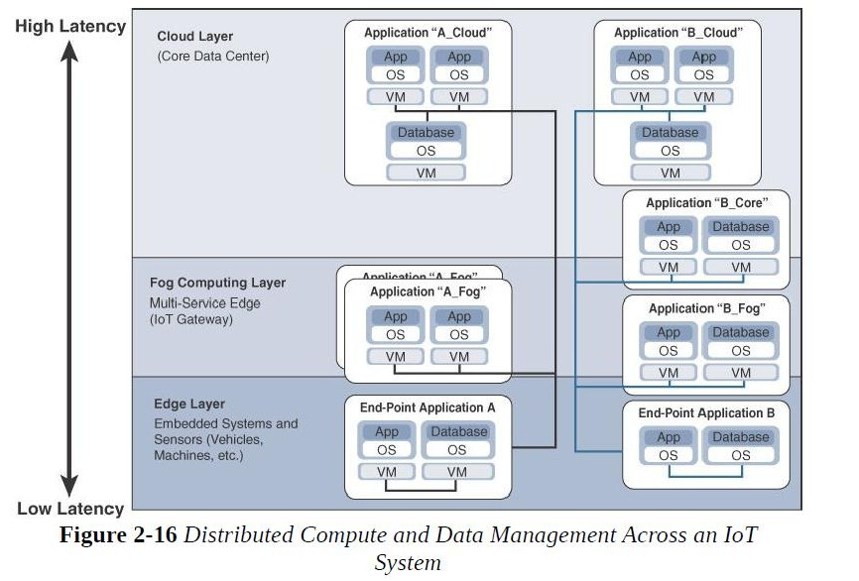

Slide 81
The fog IoT application directs different types of data for analysis:
The most time-sensitive data is analyzed on the edge or fog node closest to the things generating the data.
Data that can wait seconds or minutes for action is passed along to an aggregation node for analysis and action.
Data that is less time sensitive is sent to the cloud for historical analysis, big data analytics, and long-term storage.

